Slide 1
Strongly Connected Components, Max Flow, Bi-Connectivity
SoftUni Team
Technical Trainers
Software University
https://about.softuni.bg

Slide 2
Table of Contents
Strongly Connected Components
Max Flow
Bi-Connectivity
2
Notes:
2

Slide 3
Strongly-Connected Components
5
9
12
13
0
7
2
The DFS-Based Algorithm

Slide 4
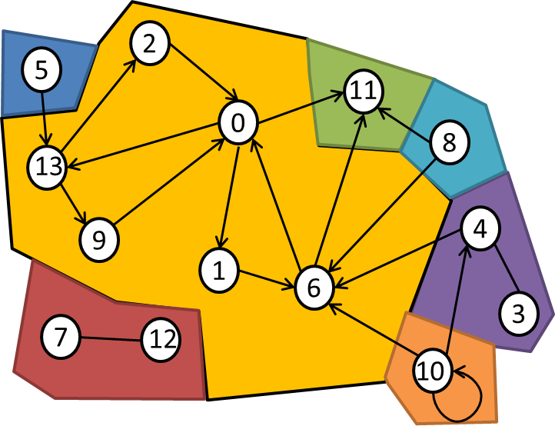
Strongly-Connected Components
A directed graph is strongly connected if there is a path between all pairs of vertices
SCC of a directed graph is a maximal strongly connected subgraph
For example, there are 7 SCCs in the following graph:

Slide 5
Strongly-Connected Components
Example of strongly-connected graph:
9
1
10
6
7
0
3
4
2
5
8

Slide 6
Practical Applications
Find groups of people who are more closely related in a huge set of data
Facebook friends recommendations
Identifying group of people for advertising
Vehicle routing applications
If the graph isn't Strongly Connected, then vehicles can get trapped in a certain part of the graph (they can get in, but not get out)

Slide 7
Kosaraju–Sharir Algorithm
For each vertex v in G (directed graph)
Call DFS(v) to traverse the graph (visit each node once)
Each time DFS(v) finishes, push v onto S (stack)
Build the reverse graph G' (reverse all edges from G)
While S is non-empty:
Pop the top vertex v from S
if v is not visited, call ReverseDFS(v) to find the next strongly-connected component
Time complexity: O(V+E)

Slide 8
Max Flow
6
6
30
0
5
22
3
8
Finding the Maximum Flow

Slide 9
Max Flow Problem
Weighted directed / undirected graph
With capacities assigned to the edges c(u → v)
Goal: compute the maximum flow from node s to node t
Each edge {u → v} holds certain flow flow(u → v)
flow(u → v) ≤ c(u → v)
For each node input flow == output flow
Max flow == sum(flow(s → v)) == sum(flow(u → t))
Total totoutput flow from s == al input from to t

Slide 10
Edmonds-Karp Max Flow Algorithm
Start from zero flow: flow(u → v) = 0 for each edge
While possible:
Find an augmenting path p from s to t using BFS such that:
For each {u → v} ∈ p → c(u → v) > 0
Keep track of the parent for each visited vertex
Reconstruct the path p using the parents
Set flow(p) as the smallest capacity c in the path p
Modify the capacities of the edges in the path p
Add flow(p) to the maximum flow
Time complexity: O(VE²)

Slide 11
Edmonds-Karp – Step #1
Start from empty flows through all edges
Find an augmenting path: 0 → 6 → 4 → 1 → 9 (increment = 17)
0/17
4
0/20
6
1
0/30
0/6
0/5
0/11
0/6
0/25
t
s
0/33
9
0
5
11
0/26
0/22
0/3
0/20
0/9
0/15
0/23
8
0/14
2
7

Slide 12
Edmonds-Karp – Step #2
Augment the flow through the path: 0 → 6 → 4 → 1 → 9 (increment = 17)
Current max flow = 17
17/17
4
17/20
6
1
17/30
0/6
0/5
0/11
0/6
17/25
t
s
0/33
9
0
5
11
0/26
0/22
0/3
0/20
0/9
0/15
0/23
8
0/14
2
7

Slide 13
Edmonds-Karp – Step #3
Find an augmenting path: 0 → 6 → 5 → 4 → 1 → 9 (increment = 3)
17/17
4
17/20
6
1
17/30
0/6
0/5
0/11
0/6
17/25
t
s
0/33
9
0
5
11
0/26
0/22
0/3
0/20
0/9
0/15
0/23
8
0/14
2
7

Slide 14
Edmonds-Karp – Step #4
Augment the flow through the path: 0 → 6 → 5 → 4 → 1 → 9 (increment = 3)
Current max flow = 20
17/17
4
20/20
6
1
20/30
3/6
3/5
0/11
0/6
20/25
t
s
0/33
9
0
5
11
0/26
0/22
0/3
0/20
0/9
0/15
0/23
8
0/14
2
7

Slide 15
Bi-Connectivity
9
5
7
0
2
Finding the Articulation Points

Slide 16
Articulation Points
In a connected undirected graph, an articulation point is a node that when removed, splits the graph into several components
The marked nodes below are the articulation points: 7, 0, 6, 4
There are 6 bi-connected components:
{5, 7}, {0, 2, 7, 9}, {1, 0, 6}, {6, 8, 11}, {4, 6, 10}, {3, 4}
9
1
10
6
3
5
7
0
4
2
11
8

Slide 17
Articulation Points – The Slow Algorithm
The straightforward algorithm – O(n * (m + n))
Remove each node and check whether the graph stays connected
Check for graph connectivity by DFS traversal + counting the number of visited nodes
foreach v ∈ graph nodes
temporary remove v
check for connectivity with DFS(u), where u ≠ v
if the graph is not connected, print v
restore v back in the graph

Slide 18
Articulation Points – The Fast Algorithm
The fast (O(V+E)) algorithm for finding articulation points is based on DFS traversal with some computations (Hopcroft, Tarjan, 1973)
Run a DFS while maintaining the following information:
The depth(v) of each vertex in the DFS tree (once it gets visited)
For each vertex v, the lowest depth reachable not from the original path of v in the DFS tree, called the lowpoint(v)
A non-root vertex v is an articulation point if there is a child y of v such that lowpoint(y) ≥ depth(v)
The root vertex is an articulation point if it has at least two children

Slide 19
Articulation Points Algorithm Preview
Build DFS tree:
d = 1
1
1
4
2
3
5
6

Slide 20
Articulation Points Algorithm Preview (2)
Build DFS tree:
d = 1
1
1
d = 2
4
4
2
3
5
6

Slide 21
Articulation Points Algorithm Preview (3)
Build DFS tree:
d = 1
1
1
d = 2
4
4
2
d = 3
3
3
5
6

Slide 22
Articulation Points Algorithm Preview (4)
Build DFS tree:
d = 1
1
1
d = 2
4
4
2
d = 3
3
d = 4
5
3
5
6

Slide 23
Articulation Points Algorithm Preview (5)
Build DFS tree:
d = 1
1
1
d = 2
4
4
2
d = 3
3
d = 4
5
3
6
d = 5
5
6

Slide 24
Articulation Points Algorithm Preview (6)
Build DFS tree:
d = 1
1
1
d = 2
4
4
2
d = 3
3
d = 4
5
3
6
d = 5
5
6

Slide 25
Articulation Points Algorithm Preview (7)
Build DFS tree:
d = 1
1
1
d = 2
4
4
2
d = 3
3
d = 4
5
3
2
d = 4
6
d = 5
5
6

Slide 26
Articulation Points Algorithm Preview (8)
Build DFS tree:
d = 1
1
1
d = 2
4
4
2
d = 3
3
d = 4
5
3
2
d = 4
6
d = 5
5
6

Slide 27
Articulation Points Algorithm Preview (9)
Discover lowest points
v | 1 | 2 | 3 | 4 | 5 | 6
depth[v] | 1 | 4 | 3 | 2 | 4 | 5
low[v] | 1 | - | - | - | - | -
1
4
3
5
2
6

Slide 28
Articulation Points Algorithm Preview (10)
Discover lowest points
v | 1 | 2 | 3 | 4 | 5 | 6
depth[v] | 1 | 4 | 3 | 2 | 4 | 5
low[v] | 1 | 1 | - | - | - | -
1
4
3
5
2
6

Slide 29
Articulation Points Algorithm Preview (11)
Discover lowest points
v | 1 | 2 | 3 | 4 | 5 | 6
depth[v] | 1 | 4 | 3 | 2 | 4 | 5
low[v] | 1 | 1 | 1 | - | - | -
1
4
3
5
2
6

Slide 30
Articulation Points Algorithm Preview (12)
Discover lowest points
v | 1 | 2 | 3 | 4 | 5 | 6
depth[v] | 1 | 4 | 3 | 2 | 4 | 5
low[v] | 1 | 1 | 1 | 1 | - | -
1
4
3
5
2
6

Slide 31
Articulation Points Algorithm Preview (13)
Discover lowest points
v | 1 | 2 | 3 | 4 | 5 | 6
depth[v] | 1 | 4 | 3 | 2 | 4 | 5
low[v] | 1 | 1 | 1 | 1 | 3 | -
1
4
3
5
2
6

Slide 32
Articulation Points Algorithm Preview (14)
Discover lowest points
v | 1 | 2 | 3 | 4 | 5 | 6
depth[v] | 1 | 4 | 3 | 2 | 4 | 5
low[v] | 1 | 1 | 1 | 1 | 3 | 3
1
4
3
5
2
6

Slide 33
Articulation Points Algorithm Preview (15)
Extract articulation points
For each pair of vertices (u, v) (except the root):
If low[v] >= depth[u]
Then u is an articulation point
If the root (DFS tree) has 2+ children, then it is an articulation point
1
4
3
5
2
6
v | 1 | 2 | 3 | 4 | 5 | 6
depth[v] | 1 | 6 | 3 | 2 | 4 | 5
low[v] | 1 | 1 | 1 | 1 | 3 | 3

Slide 34
Articulation Points – Fast Algorithm
findArticulationPoints(node, d)
visited[node] = true
depth[node] = d
lowpoint[node] = d
childCount = 0
isArticulation = false
foreach childNode in graph[node]
if not visited[childNode]
parent[childNode] = node
findArticulationPoints(childNode, d + 1)
childCount = childCount + 1
if lowpoint[childNode] >= depth[node]
isArticulation = true
lowpoint[node] = Min(lowpoint[node], lowpoint[childNode])
else if childNode <> parent[node]
lowpoint[node] = Min(lowpoint[node], depth[childNode])
if (parent[node]<>null and isArticulation) or (parent[node]==null and childCount > 1)
print node as articulation point

Slide 35

Summary
Strongly-connected components
Use DFS + reverse DFS algorithm
Maximum flow → Edmonds-Karp
Articulation points → use modified DFS
Notes:
35

Slide 36
Questions?
Notes:
36

Slide 37














SoftUni Diamond Partners

Slide 38

License
This course (slides, examples, demos, exercises, homework, documents, videos and other assets) is copyrighted content
Unauthorized copy, reproduction or use is illegal
© SoftUni – https://about.softuni.bg/
© Software University – https://softuni.bg
Notes:
38

Slide 39
Trainings @ Software University (SoftUni)
Software University – High-Quality Education, Profession and Job for Software Developers
softuni.bg, about.softuni.bg
Software University Foundation
softuni.foundation
Software University @ Facebook
facebook.com/SoftwareUniversity
Software University Forums
forum.softuni.bg
Notes:
39

